Slide 1
OSU Forestry Extension in 2013 and Beyond
Sam Angima – Regional Administrator

Slide 2
Extension Programs (North Coast)
North coast regions has many Extension programs
Small farms
Forestry
Child care resource and referral system
Disaster preparedness programs
Youth education
Nutrition and fight against childhood obesity
Youth & adult literacy programs
Master Gardening program
North coast regions has many Extension programs
Dairy and livestock programs
Strong women program
Aging wisely program
Aquaculture
Fisheries
Fishery products & Marketing
Hispanic Nutrition program
Local foods connection program
General nutrition program

Slide 3
Current Structure from OSU down to the chair of each Extension Office and the Extension Forester

Slide 4
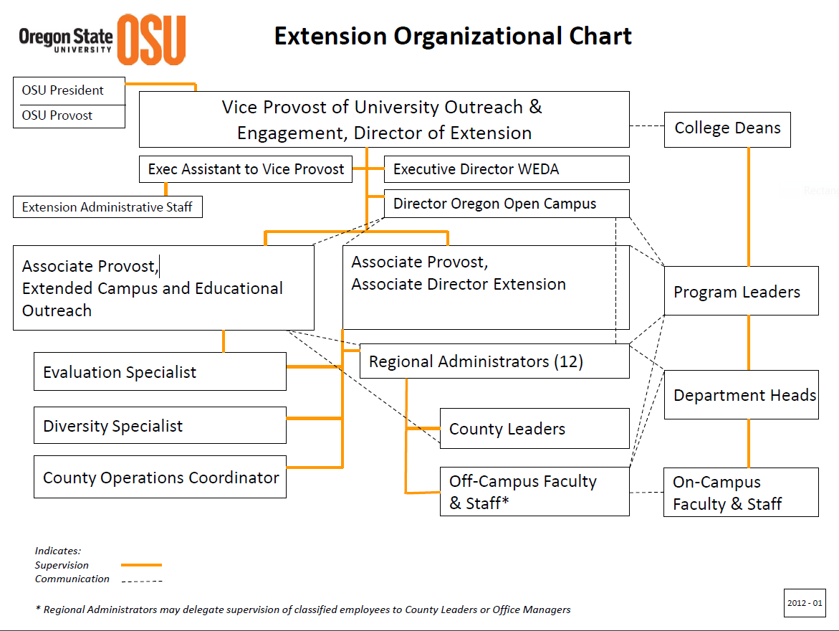

Slide 5
Vision & Mission - Forestry
Vision – Oregon will have healthy, diverse, and resilient forest and related natural resources to support both Oregon’s resource-dependent industries and citizen needs for energy and ecosystem services.
Mission – Oregon State University’s Forestry & Natural Resources Extension Program is the state’s leading provider of research-based knowledge and problem-solving educational programs designed to foster new ways to manage and use Oregon’s forest resources wisely.

Slide 6
State Forestry Program
Since 2009 (4 years) the forestry program has seen a continued decrease in funding of about 30% from the state
State harvest timber $$$ has offset some of this decline
In 2006 we had 4.4 FTE over seven people in N. coast and N. Willamette valley
In 2012 we had 4.0 FTE with only four people
OSU system 192 FTE – to 154 FTE in last four yrs

Slide 7
Staffing Survey
Survey in 2012 for staffing sent to
Extension agents
Extension specialists
CoF executive committee
Forestry education partners
ODF
Oregon Forestry Resources Institute
Oregon Small Woodlands Association
Oregon Tree Farm System
NRCS
Western Forest & Conservation Association
Associated Oregon Loggers
USA Forest Service
Oregon Board of Forestry

Slide 8
Survey Results
Hire a replacement agent for Lane County –if local support funds are available
Hire a replacement agent for Klamath and Lake Counties, with a base in Klamath Falls
Hire one or more Forestry Program Assistants in key regions with high demand.
Seek local support to fund EPAs
Will be supervised by regional forestry agents
Replace all three existing specialist vacancies in the following order: Silviculture; Timber Harvesting & Engineering; and Forest Policy, Economics and Taxation.
Consider new specialists, but after the existing positions have been filled. Priorities include Wildfire and Reforestation.

Slide 9
County Vs Regional Assignments
Field agents preferred
County model (46%)
Regional model (36%)
Partners favored
County model (50%)
Regional model (38%)

Slide 10
Natural Resource Education in Clatsop Co. – Ongoing
Community members have come together to formulate how to handle current staffing issue related to natural resources education
Needs assessment
Program evaluation
Developing educational strategies
Communication
Participation and who benefits from program

Slide 11
OSU Forestry Faculty – Regions What are the Forestry Extension programs at each extension area across Oregon?

Slide 12
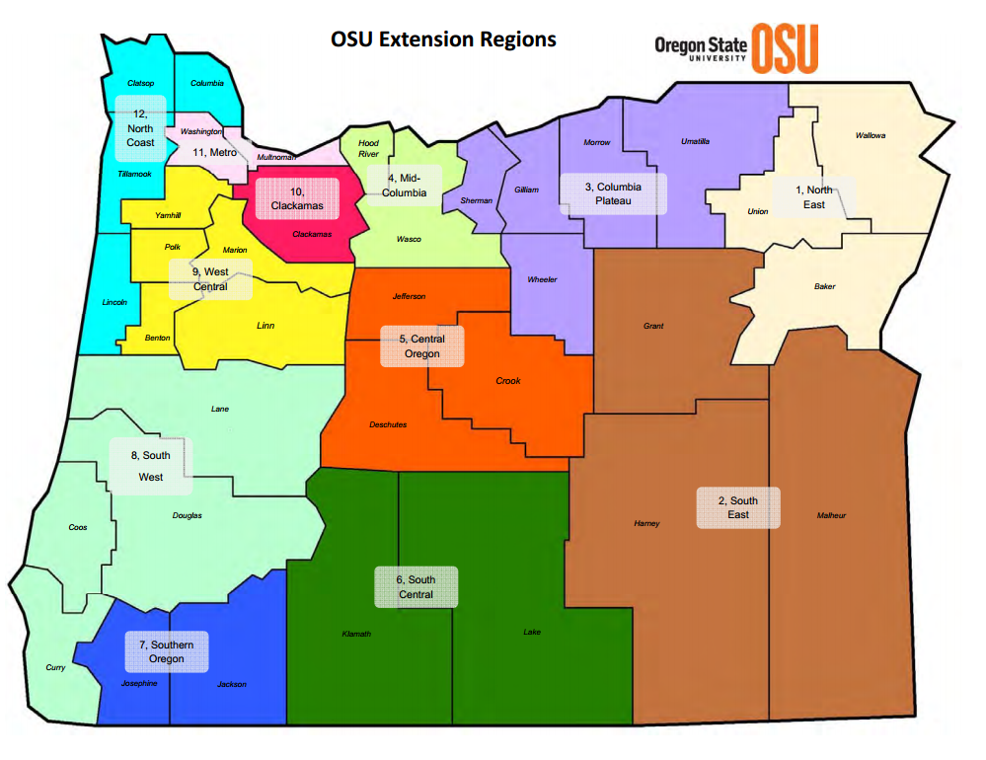

Slide 13
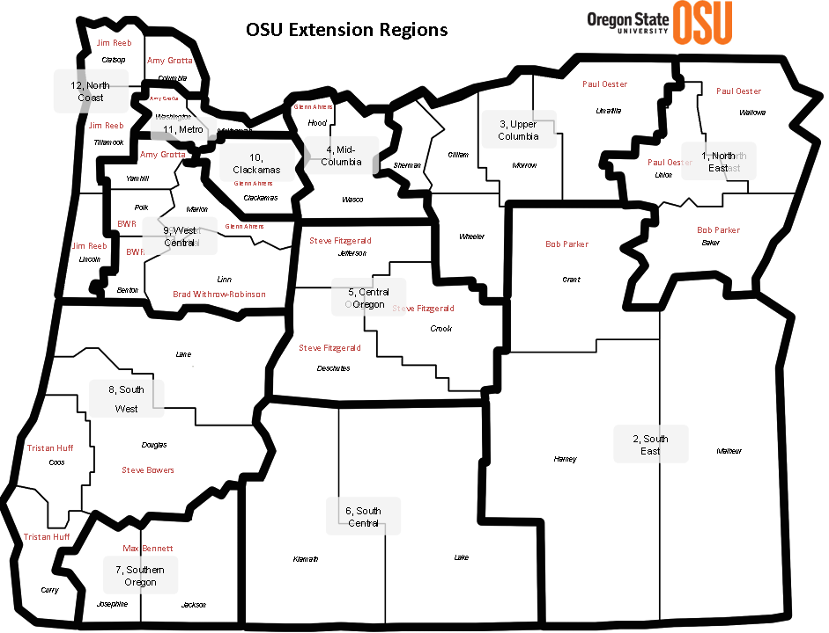

Slide 14
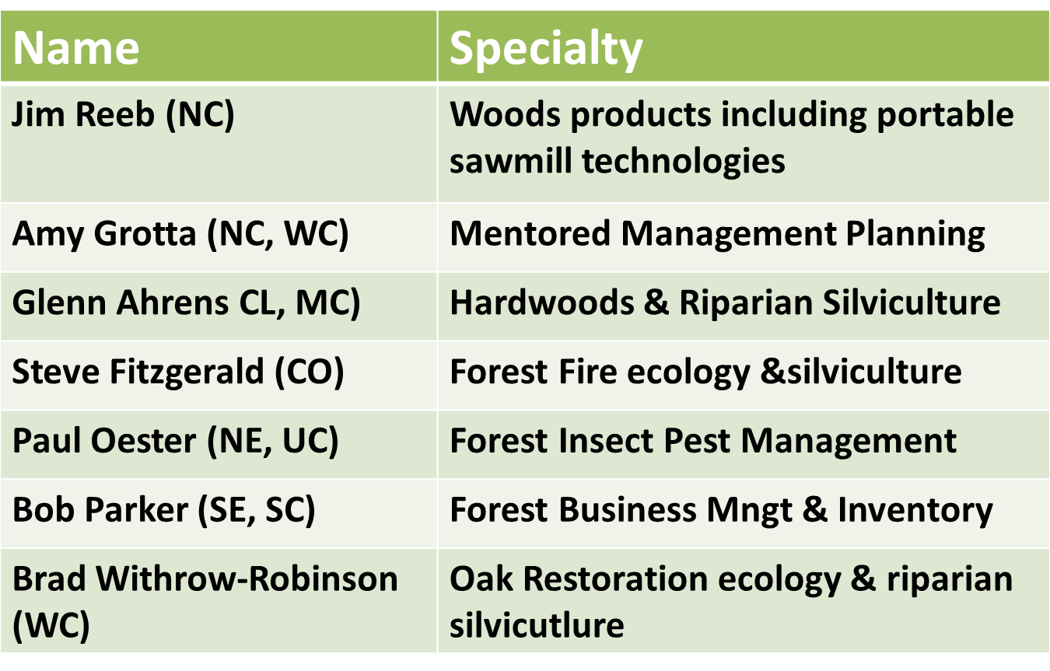
OSU Forestry Faculty - Regions

Slide 15
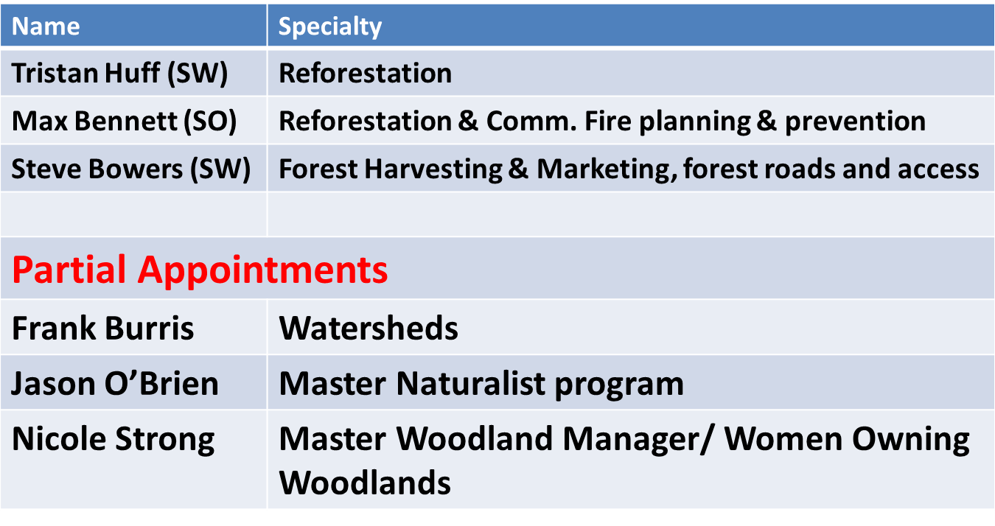
OSU Forestry Faculty - Regions

Slide 16
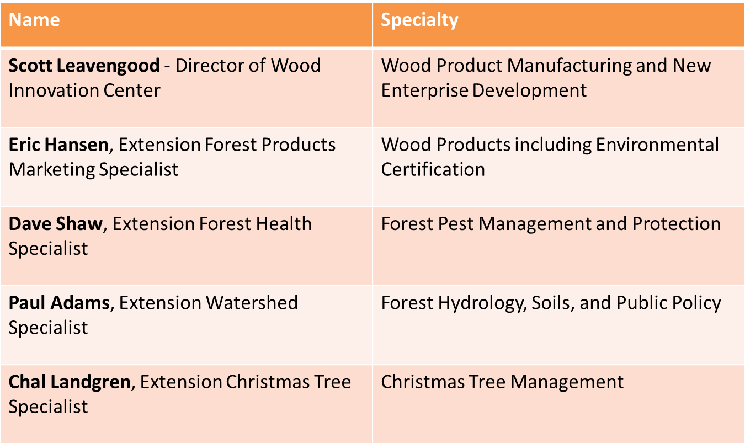
OSU Forestry Faculty - Statewide

Slide 17
What will be the program emphasis in the Lincoln, Tillamook, and Clatsop County area?

Slide 18
Overview of 3-County Area
County For. Ac Private Owners
Clatsop 452,000 308,000 601
Tillamook 641,000 183,000 679
Lincoln 565,000 355,000 1,195

Slide 19
Community Engaged Scholarship
OSU earned the prestigious Carnegie Engaged Institution status in 2011
Rigor is not based solely in procedures utilized, but rather in the openness and transparency of the scholarly enterprise that welcomes active participation on an equal basis by academic and community scholars and practitioners.

Slide 20
Needs Assessment
Define needs
Gap between what is condition and what is desired
What is desired (measurable) defined by stakeholders
Moving away from outreach to engagement where partners are equal participants in creating and shaping knowledge in other words embracing mutualism and reciprocity.
Outreach begins with an answer and engagement ends with one
Given reduced FTE, this is what can work best

Slide 21
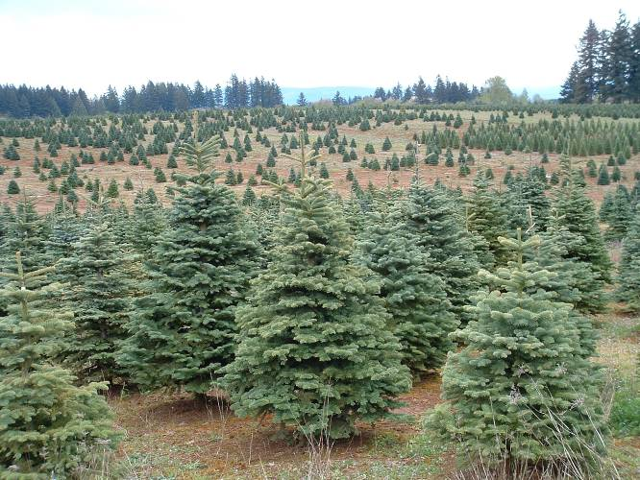
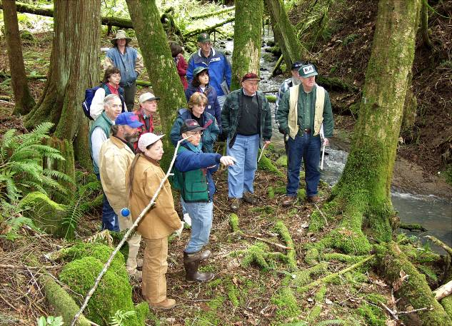
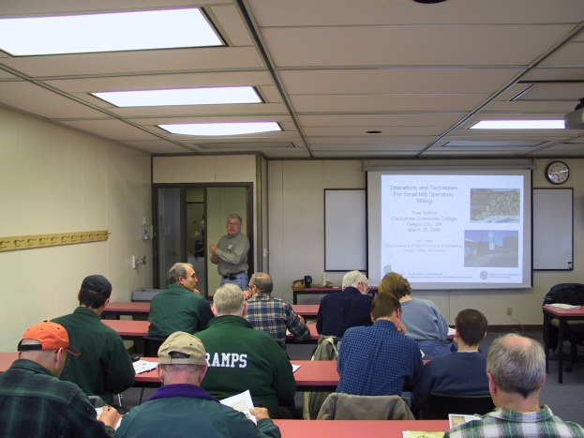

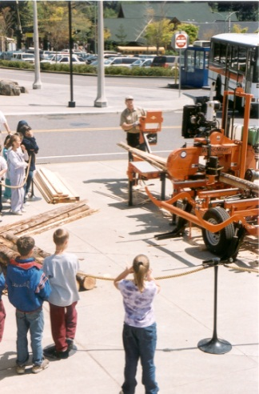
OSU Extension Forestry & Natural Resources
*Master Woodland
Manager Program
*Basic Forestry
Short Course
*Ties to the Land
*Management plans
*Tree Schools
*Backyard Forestry
*Forest health
*Marketing, harvesting
*Roads
*And More…
*Wildland fire education
*Christmas trees
*Wood Innovation Center
*Forest Industries Directory
*Forest products industry training
*International forestry study tours
*Wood Magic

Slide 22
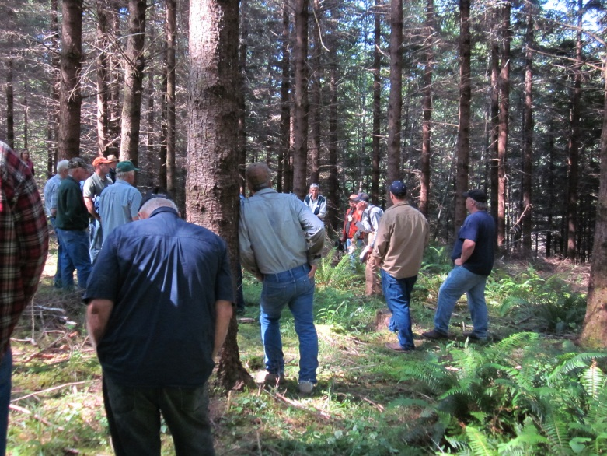
Forestry and Natural Resources
Extension Program
Clatsop, Lincoln and Tillamook Counties
Audiences include: family forest landowners, industry, youth, other forestry professionals and the general public.
Planned Program Time Allocation:
Landowners 80%
General Public 15%
Industry 5%

Slide 23
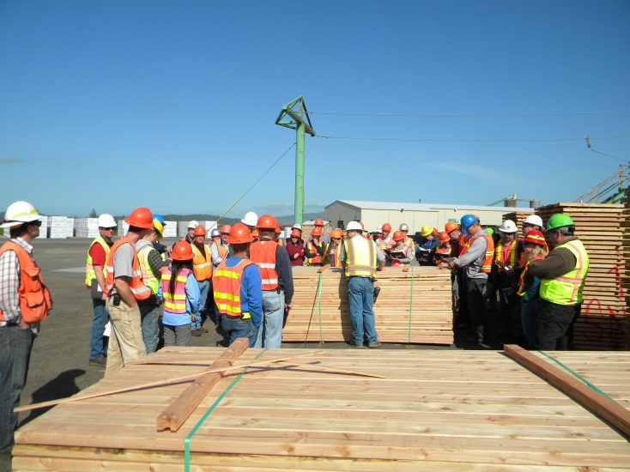
2013 Planned Programs:
Title: Compare efficiency and costs of traditional heating fuels with firewood and wood pellets. Lecture/computer lab at Community Colleges.
Audience: General public
Title: Using the Web Soil Survey and other internet mapping tools. Lecture/computer lab at Community Colleges.
Audience: Ag and forest landowners
Title: Living with fire on the Oregon central and
north coast.
Audience: Landowners and public living in the
wildland-urban-interface

Slide 24
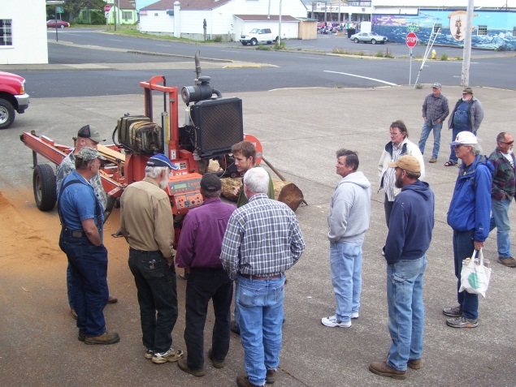
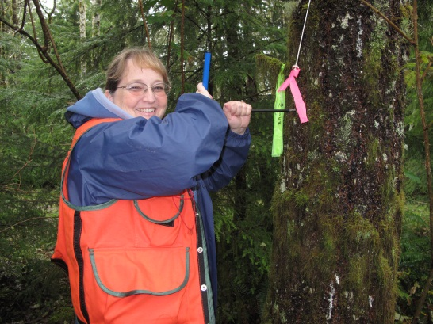
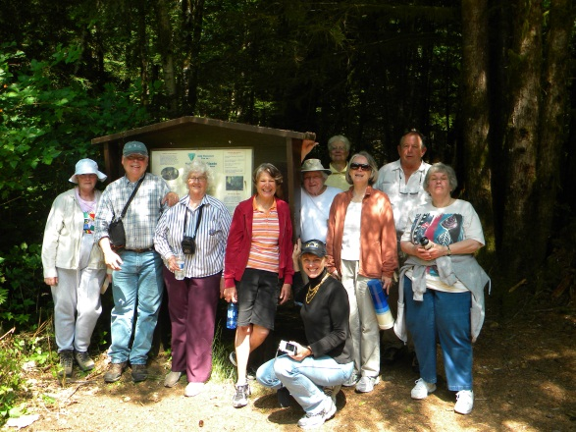
2013 Programs (continued):
Title: Wood as a material: how wood behaves.
Audience: Industry, carvers, general public
Title: Ecology and biology of Oregon coast forests
Audience: Landowners
Title: Forest inventory and mapping
Audience: Landowners
Title: Regeneration and silviculture
Audience: Landowners

Slide 25
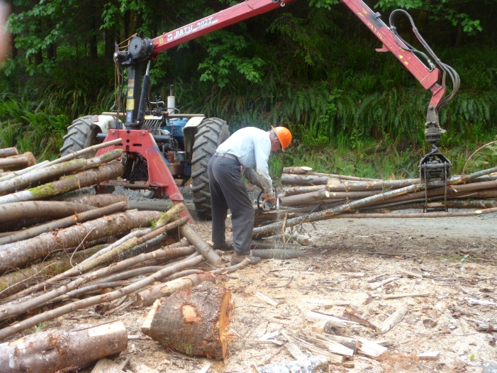
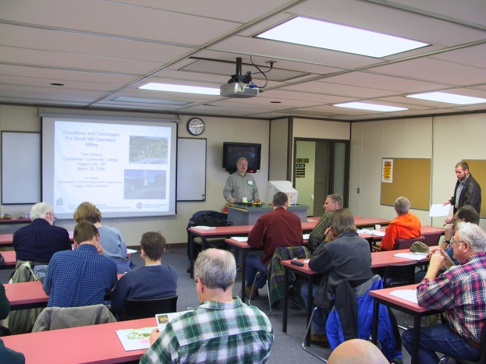
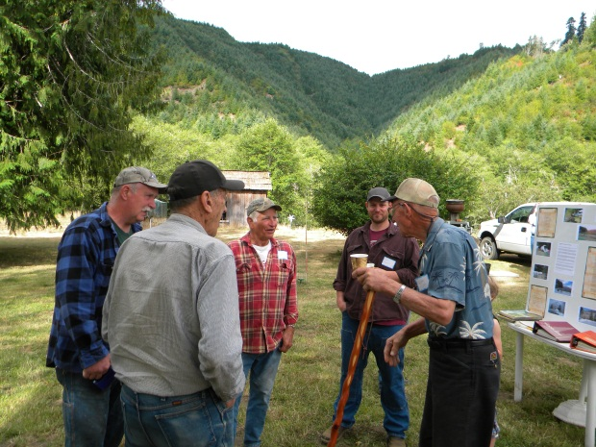
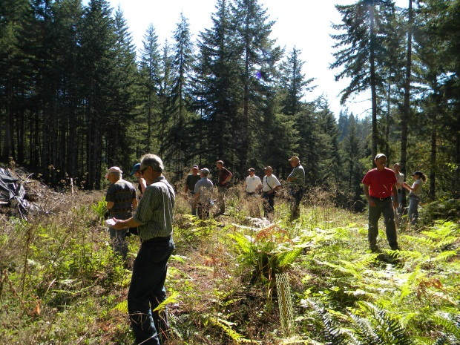
2013 Programs (continued):
Title: Business and legal aspects of owning forest
property
Audience: Landowners
Title: Marketing and selling your timber
Audience: Landowners
Programs will include lectures, hands-on and field exercises.

Slide 26
Will our OSU Extension Forester be available to help write Small Woodland owners management plans under the new 2010-2015 OTFS? Three of us SAF members are trained Tree Farm Inspectors, but we shouldn't be asked to write these plans

Slide 27
Management Plans
Generally our Extension Foresters do not prepare management plans for forest owners
This is “not in their position description.”
However, several of our Extension Foresters are also trained inspectors for the Oregon Tree Farm System, and they do occasionally do inspections and re-inspections on a voluntary basis.
But, our Extension Foresters do management planning educational programs and often will mentor forest landowners in working on their own plans.
Also, one of our Extension Foresters, Tristan Huff, works with OTFS to conduct training for inspecting foresters.
So, OSU does provide a lot of support to the Oregon Tree Farm System

Slide 28
Thank you

